Slide 1
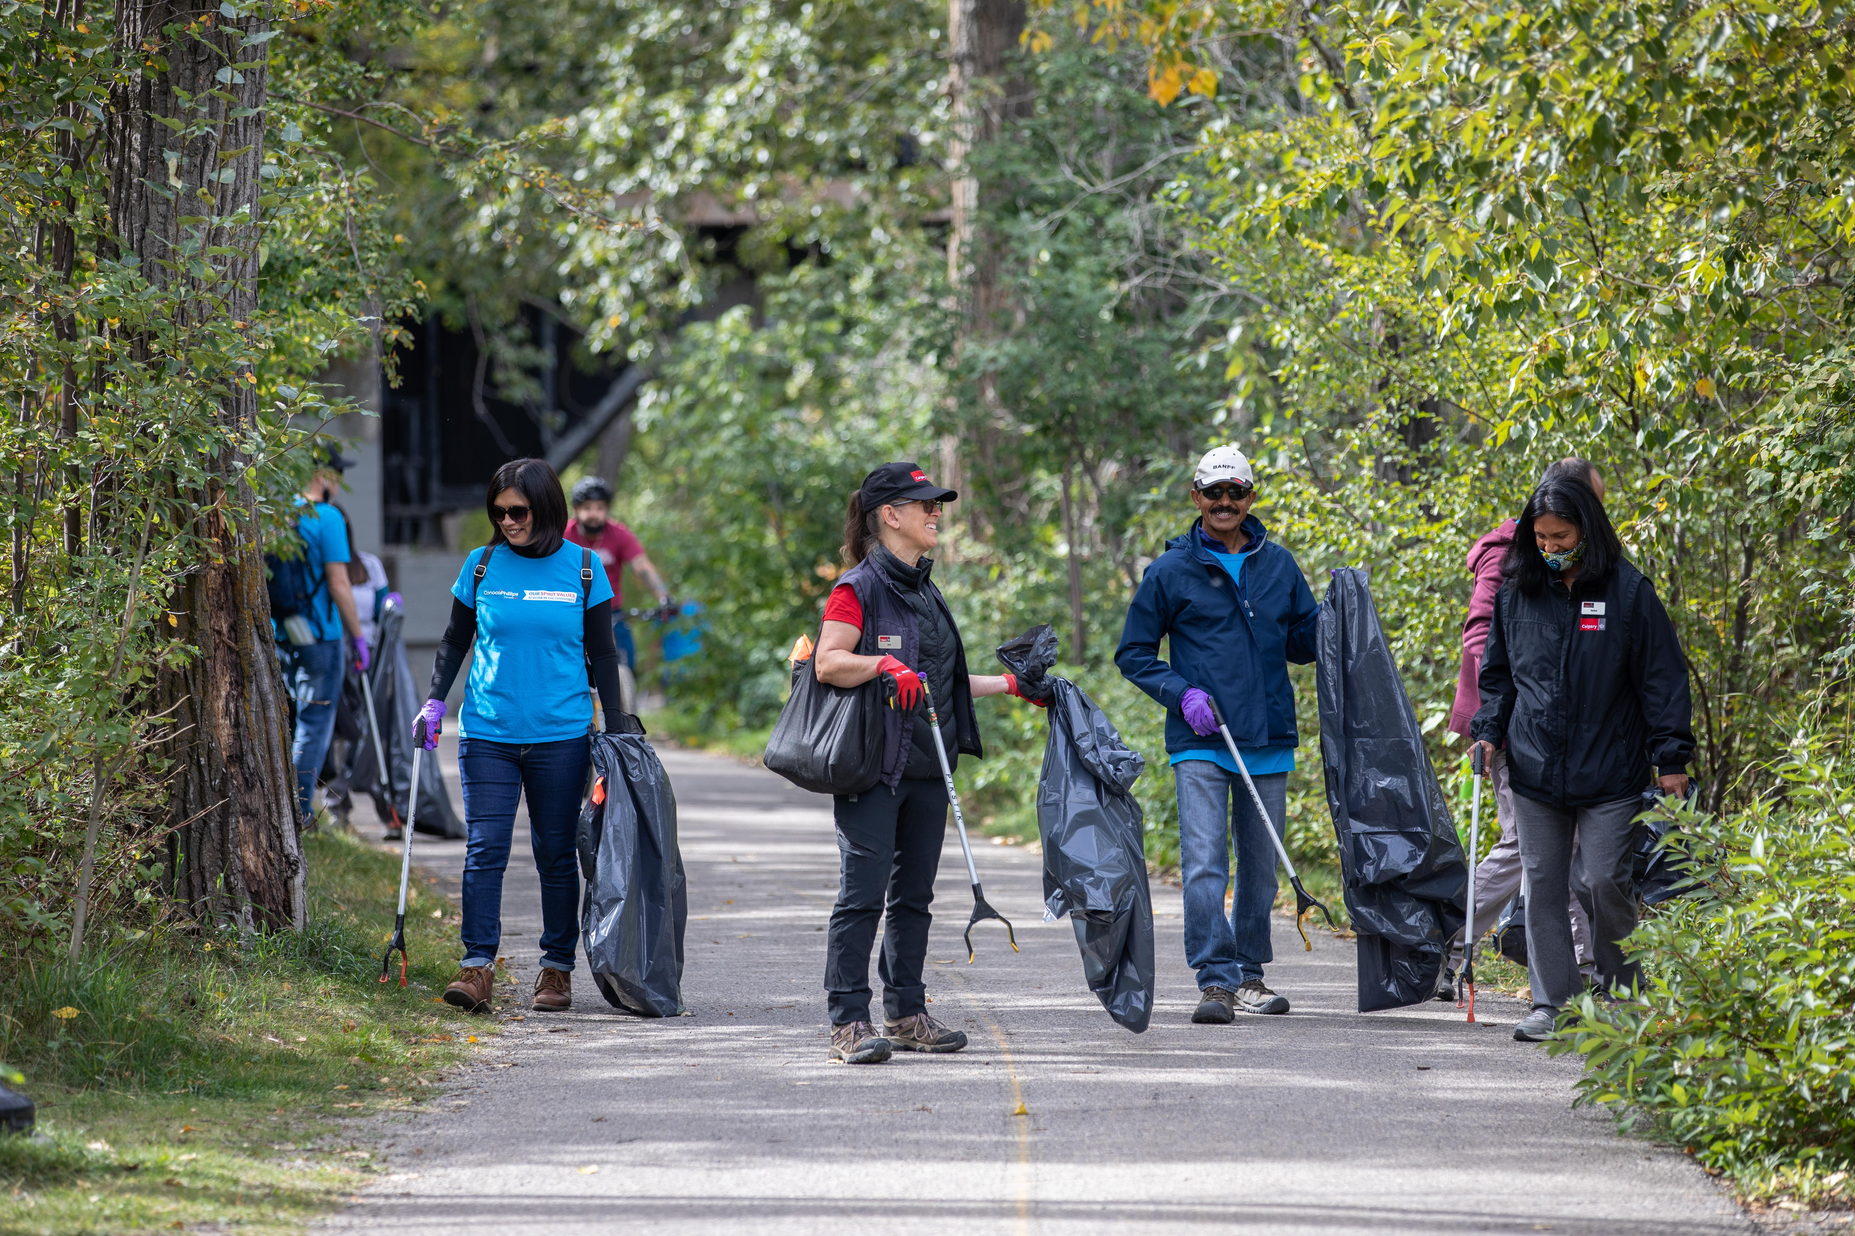
Module 5: Asset collecting, connecting and weaving

Slide 2
Asset collecting,
connecting and weaving
Collect
Connect
Weave

Slide 3
Collect assets
The first asset is the gifts, skills and passions, and knowledge of residents.
  Ask – What are your gifts, skills, passion and knowledge?
The second asset is local clubs, groups and associations.
  Ask – What groups or associations do you or your family participate in?
The third asset is local institutions. There are three kinds: for-profit, not-for-profit and governmental.
  Ask – What services or programs do you access? What local businesses do you support?
The fourth asset is the land.
  Ask – How do you value, respect, connect with the land? Where do you go to hang out and have fun?
The fifth asset is all kinds of exchanges. This includes giving, sharing, trading, bartering, exchanging, buying and selling, time banking, co-ops.
  Notice – How do people respond if you suggest a trade or barter? What are the cultural norms for how people exchange or share?
The sixth asset is culture, stories and history.
  Notice – What stories do people share about the history of the neighbourhood? What are they proud of?
  Ask – Share about a time this community came together to solve a problem or celebrate.

Slide 4
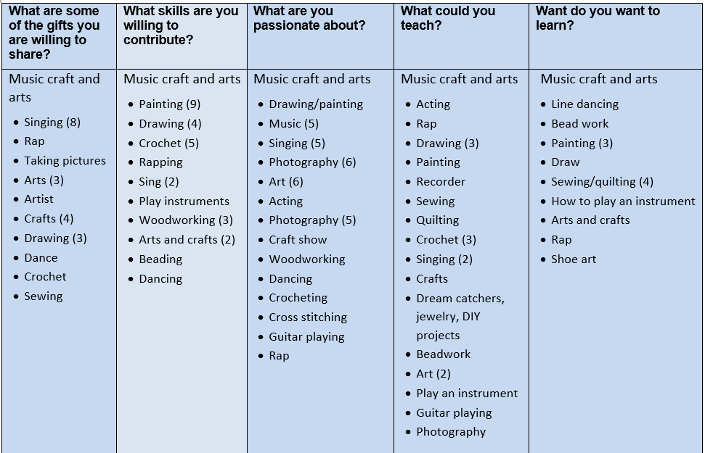
Sample list of assets

Slide 5
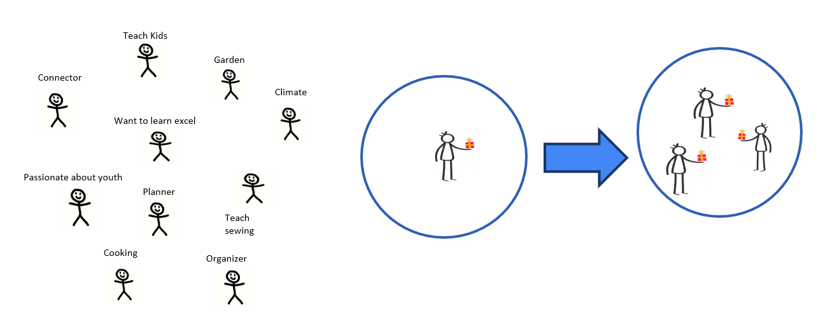
What to do with your assets?
Want to learn Excel
Connect the assets
so that people can
work together

Slide 6
Five ways to connect
Identifying more connectors – These are people who have connector interest (those who identify that they like being in groups, greeting, welcoming people) they are the activators.
Matching one to one – Two people with the same interests sharing and learning together. Connect two gardeners together or a gardener and someone who wants to learn to garden.
Matching a person to a group of same interest – If you find someone who is interested in supporting youth, you connect them with a youth club/group.
Identifying people to do events/activities – We imagine an event and put together people who have skills to do it – either an existing event or create a new one.
Reinforcing activity – Those who have diverse gifts that could reinforce each other. A cookie baker and a businessperson could open a cookie shop.

Slide 7
Connecting example

Slide 8
Weaving example
Activity | Health | Care | Security | Children | Economy | Ecology | Food production
Connect walkers together | People get active | Builds relationships | Eyes on the street |  | Stop at local business for water | Picking up litter
Cooking classes | Eating healthier |  |  | Kids attend the classes and learn/teach | Buy local foods |  | Big batch cooking and sharing with neighbours
Fix it café |  | Retired professionals using gifts and contributing |  |  |  | Reduce waste, and reuse and repurpose | Food preparation and exchange production
Craft show |  | Social connectedness |  | Teach children new skills | Bartering and selling local crafts

Slide 9
Community-led
1. As a community, what can we achieve by using our own assets?
2. What can we achieve with our own assets plus some outside help?
3. What can’t we do with our assets alone? What must be done by external groups?

