Slide 1
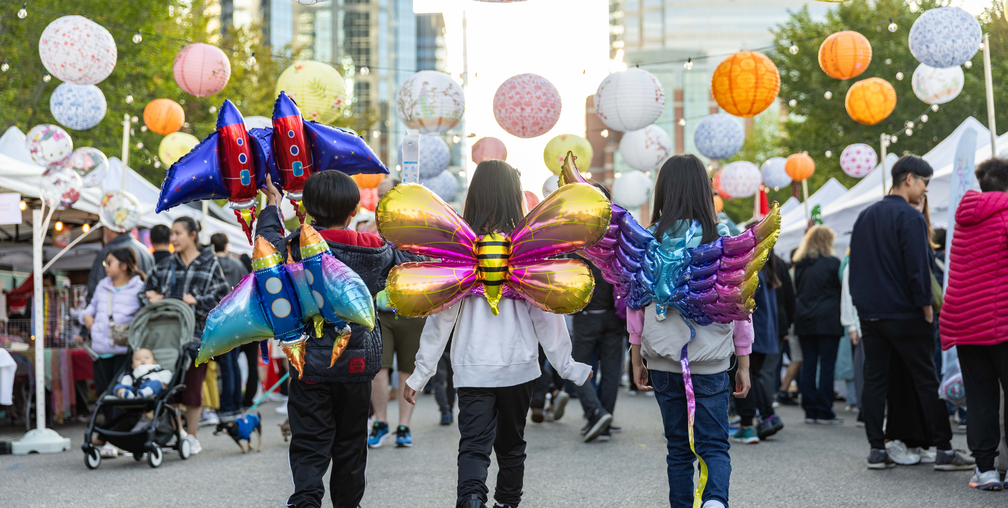
Module 1: What is Asset-Based Community Development?

Slide 2
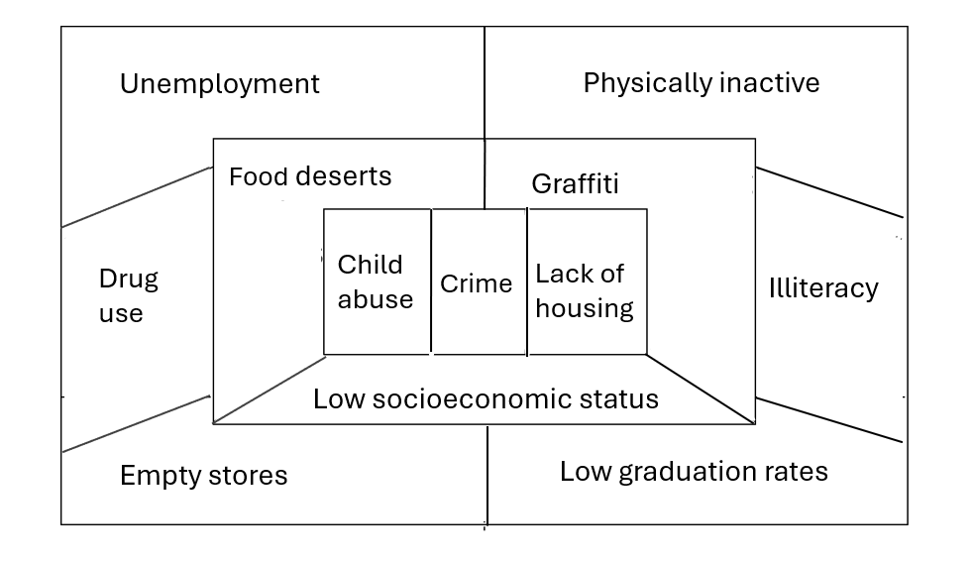
Needs Map
Starting with scarcity lens can lead to “top down” solutions.
When addressing needs, community is changed through increased services, programs and activities.

Slide 3
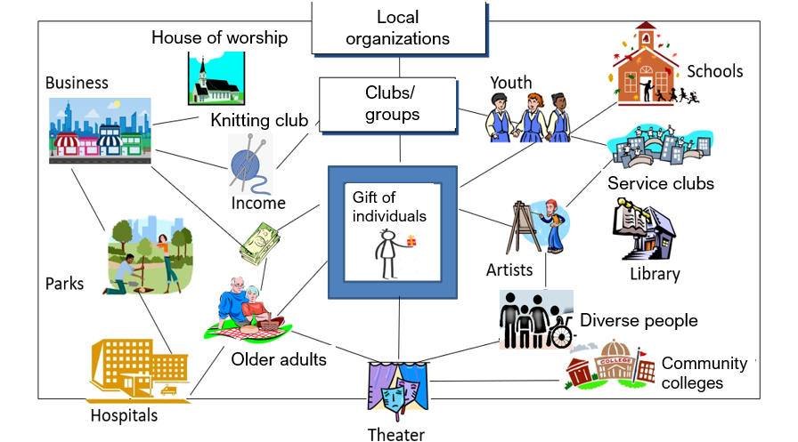
Asset Map
Start with what you have in the community.
Work from the inside out.

Slide 4
The how of ABCD
Resources: There are six types of assets or resources that are found in every community that can contribute to local wellbeing.
Nine functions: By utilizing the six resources and methods that connect residents, communities can perform nine indispensable functions. These functions are crucial aspects of all naturally occurring communities.
Methods: Connected communities use methods that involve identifying and weaving local resources effectively.
NOTE: As you work through ABCD in your community be aware of the systemic barriers that limit the full participation of residents. The implementation of the ABCD approach requires an intentional effort to identify and remove barriers to participation.

Slide 5
Assets Found in a Community
Gifts of local people
For profit/not for profit/
government
Sharing/
trading/
bartering
Clubs/
groups/ associations
Land/
places
Culture/
stories/
history

Slide 6
Methods
Discover
Welcome
Connect
Share
Celebrate
Vision
Communities have numerous ways to connect and mobilize their assets. Asset-Based Community Development approaches are flexible and evolving.

Slide 7
Nine functions of a community
Enabling health – Our neighbourhoods and other small hyperlocal places are the primary source of our health.
Community safety – The more people you know by name in your community, the more secure you may feel in your neighbourhood. This is largely within our domain.
Ecology – How we transport ourselves, how we heat and light our homes, and how much waste we create are major factors in saving our earth.
Economies – Many enterprises begin locally, in garages, basements and dining rooms.
Food production – Our backyards and community gardens contribute to our health and wellbeing, as well as our local economic renewal and environmental sustainability.
Raising children – We all say that it takes a village to raise a child, but it is very common for families to feel like they need to go it alone.
Co-creating care – We cannot purchase care. Care is the freely given commitment from the heart of one to another.
Celebrate together – Why have a meeting when you can have a party!?
Inclusiveness – Creating a welcoming space for all people, sharing cultures and gifts.

Slide 8
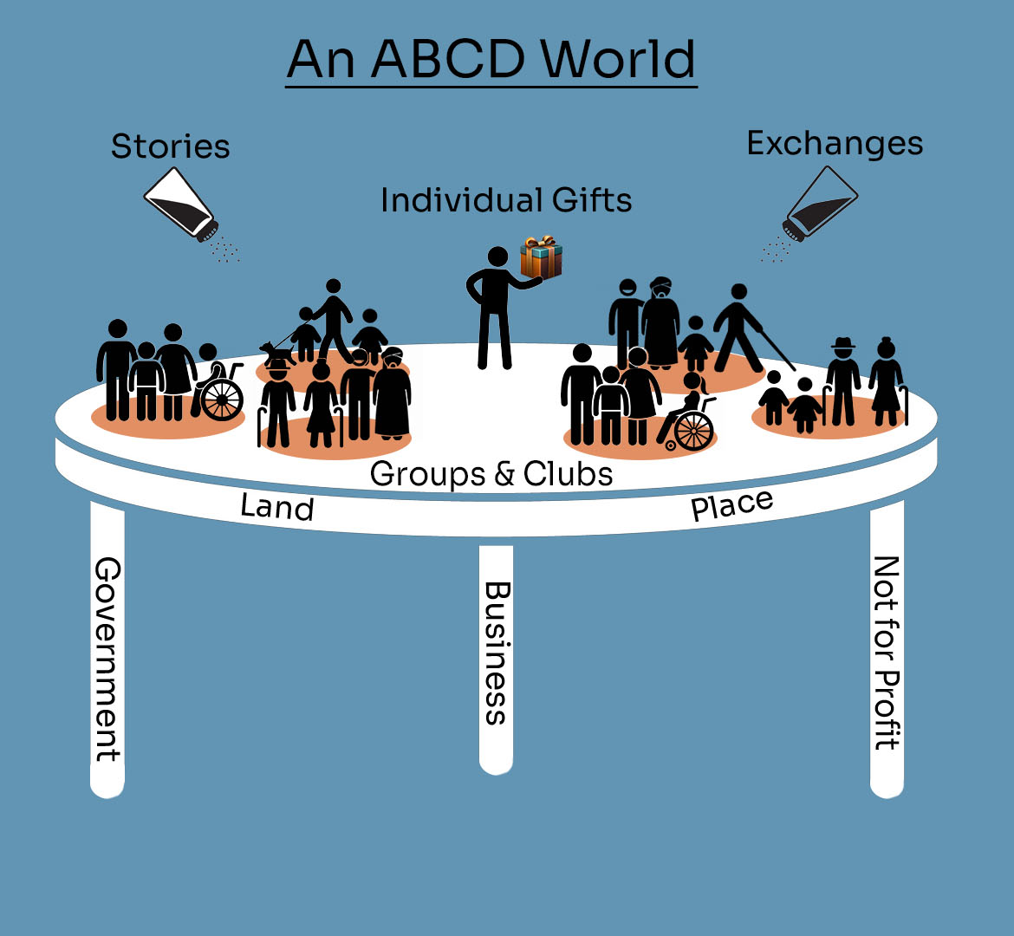

Designer: Cassandra Reid

