Slide 1
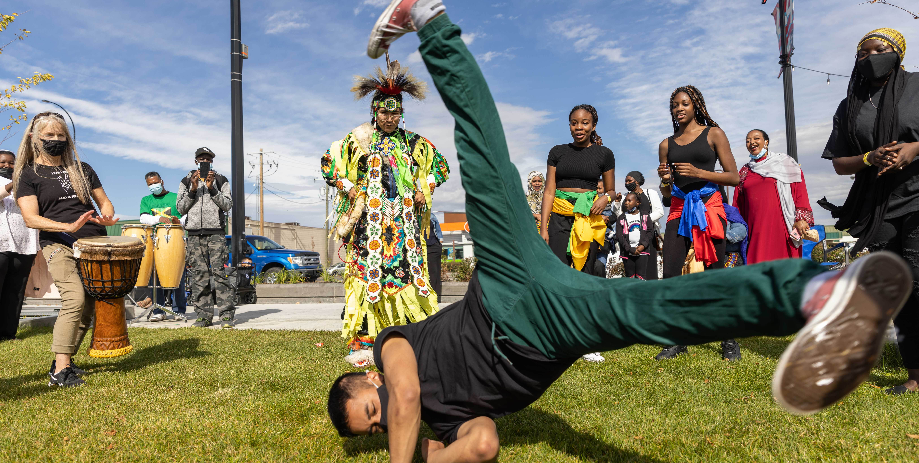
Module 6: Bringing it all together

Slide 2
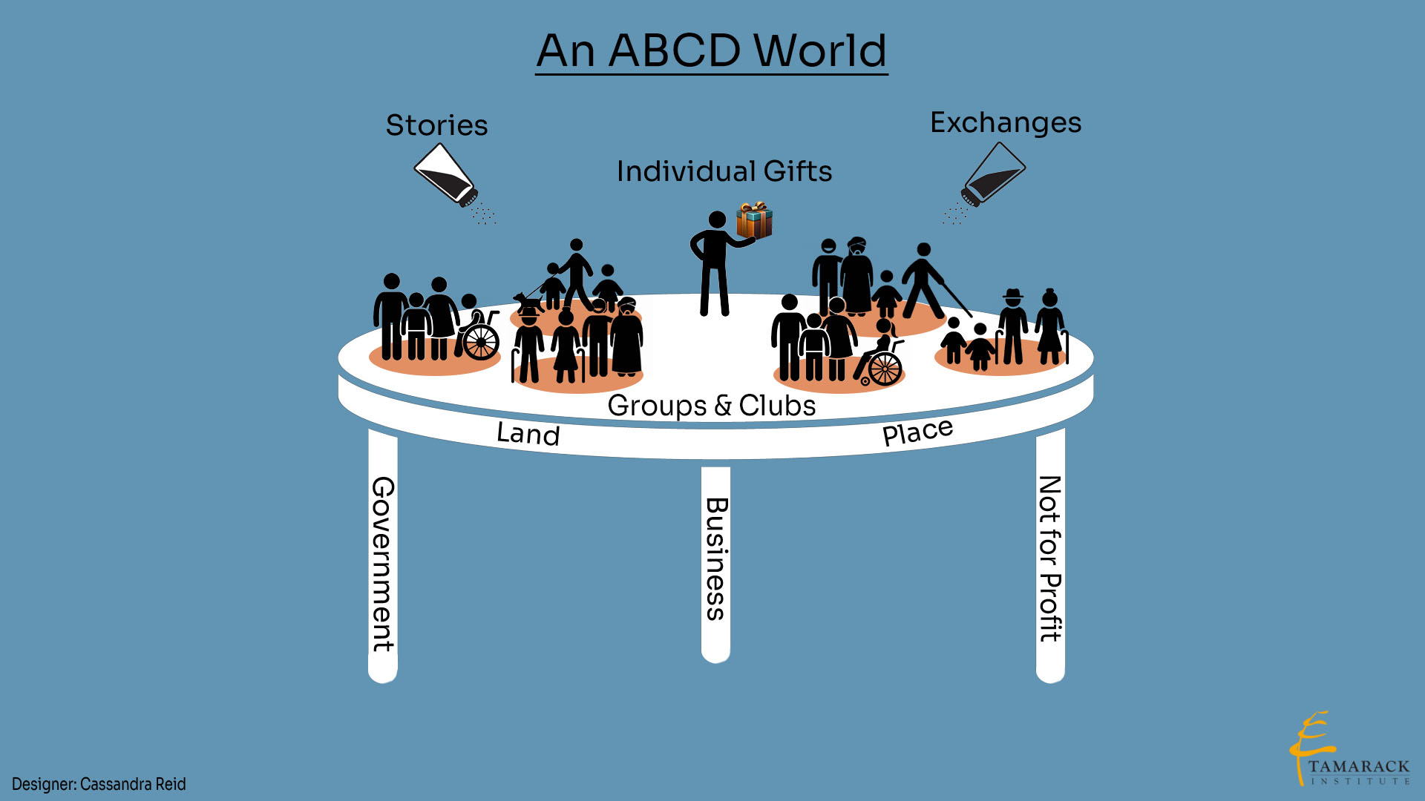

Bringing it all together
Connectors uncover the resources, gifts, skills, passions, knowledge of the community
What can be brought together to perform community functions?
Nine community functions
Inclusion
As a community, what can we achieve by using our own assets?
What can we achieve with our own assets if we get some outside help?
What can’t we do with our assets that must be done by outsiders?
Local places & land
Celebrating
Co-creating care
Security
Enabling health
Local economies
Raising children
Local food production
Notes:
The top of the table is where people preform the functions that they are meant to do
To preform the functions, they need local resources ( gifts and assets)
These resources are activated by connectors who uncover and connect the assets and resources

Slide 3
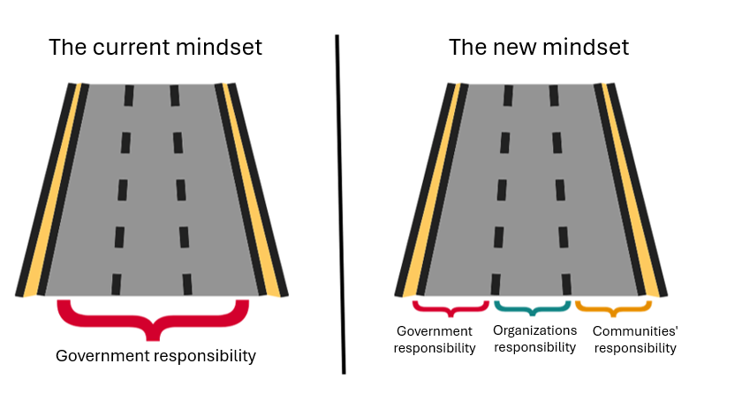

Slide 4

Congratulations, you have completed the modules!!!
To learn more about ABCD and stay connected email us at ABCD@calgary.ca, call 311 or visit:
calgary.ca/ABCD
tamarackcommunity.ca

