Slide 1
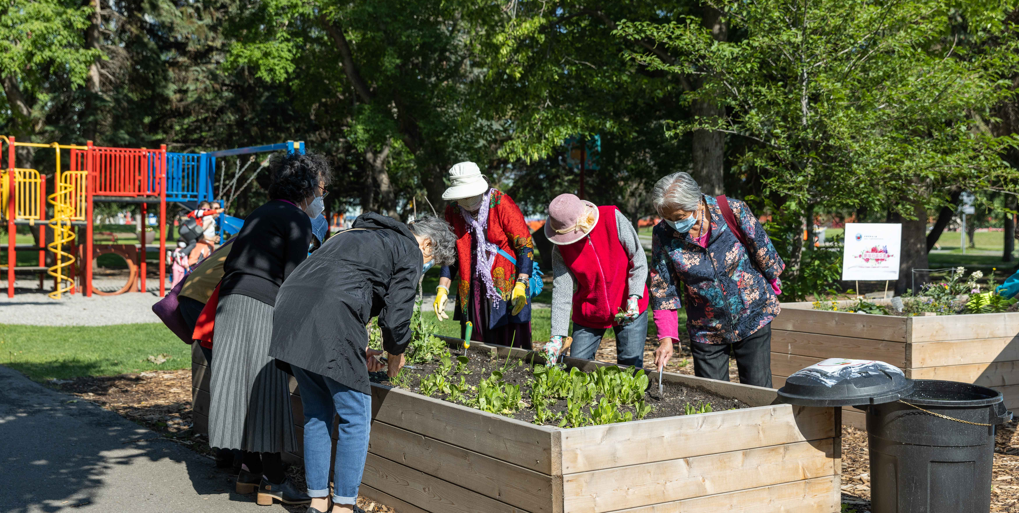
Module 3: Finding connectors

Slide 2
Who are the Community Connectors?
Organizations
(staff)
Community groups and clubs
(volunteers)
Paid connectors
Natural connectors
Citywide
scale
Local

Slide 3
Role of a connector
Being able to build relationships and make connections between people from different backgrounds. Being a relationship connector.
Being able to find and bring together people and resources in communities and groups.
Being a good team player, extending trust, welcoming and handling situations with sensitivity.
Asking who is missing and how we can connect with them.
Being creative, curious and a good listener.
Having a deep dedication to building communities, fostering relationships and including everyone.
Helping to bring in voices of those have been historically excluded from participating in the community.

Slide 4
How to find a connector
  Look for networking groups (groups that are already formed and meeting) such as coffee groups, different age groups, the community elder, cultural or interest groups.
  Ensure that connectors are representative of their community and have varied life experiences.
  Participate in community activities and volunteer so that you get to know people that might be a good fit to be connectors.
  Have snowball conversations. Ask people in the community who they know is a connector, and then ask other people who they know and so forth. Then once you hear the same one to two names, that could be your person.
  Organize a networking gathering. The people who like to connect and meet people will show up. It might just take a few events to get traction or momentum.
  Go to where people are talking, and sharing ideas and opinions, such as community group meetings or Council meetings ( i.e. school and City) to see who likes to speak their minds. Talk to those who organize community meetings. They may not be the ones who speak but are great connectors.
  Observe people at events and see who keeps coming out to your events. Who brings people with them?
  Finding someone's “why” and create different points of entry so people can come in.
Remember that ABCD is about building relationships. Explore the community and talk to different people in the community individually and get to know them.

