Slide 1
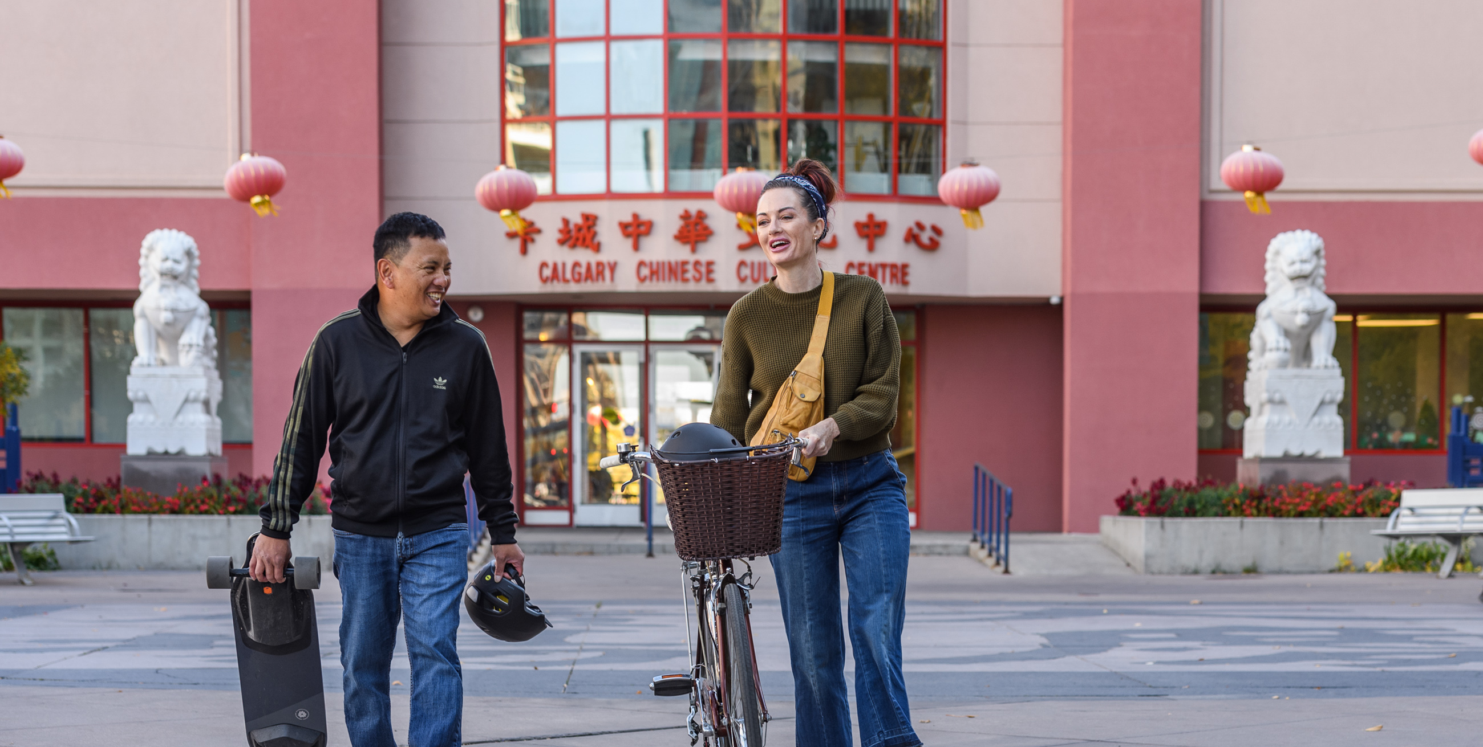
Module 2:
Building trust and relationships

Slide 2
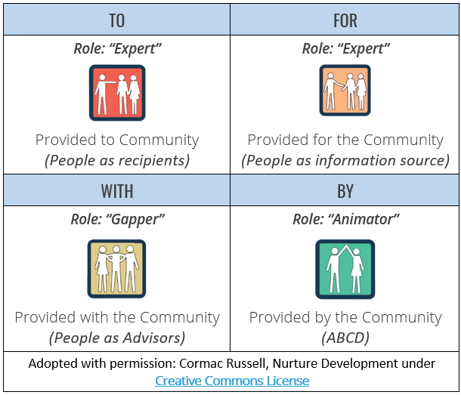
Understanding our relationship with a community
Role: Expert
Role: Expert
Provided to community
(People as recipients)
Provided for community
(People as information source)
Role: Gapper
Role: Animator
Provided with the community
(People as advisors)
Provided by the community
(ABCD)

Slide 3
Authentic engagement
Understand the story of place – Do we understand our relationship to the community, why we are engaging and how deep we should go?
Recognize all expertise – How can we ensure context expertise (those who have lived experience of a situation) is amplified and integrated into the work? How can we truly listen, learn and reduce barriers to participation?
Understand power – How can we be a power broker so that those closest to issues can shape outcomes? How can we understand systemic barriers to participation and access to power?
Ensure contribution – How can we ensure that all people contribute in meaningful ways?
Show accountability – How can we demonstrate that we listened and that the communities’ contributions shaped the outcome?

